Slide 1

Criminal Weather
In the city of Denver
Melanie Nolker
Lisa Stroh
Kathy Nguyen
April Lagnevall
Haifa Najdawi
Notes:
Melanie

Slide 2
Motivation & Summary
Does weather have an impact on a crime?
Find if there is a correlation in non-traffic crime in the city of Denver compared to various weather conditions.
Hypothesis: Weather has an impact on non-traffic crime in Denver.
Null Hypothesis: Weather does not impact non-traffic crime in Denver.
2
Notes:
Kathy

Slide 3
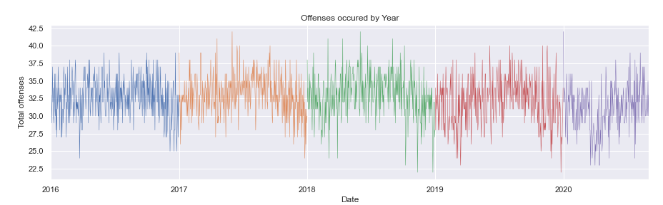


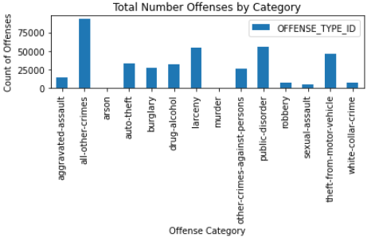

Questions & Data
Is there a correlation between crime & weather?
What type of offenses will be used to analyze crime rates?
What weather conditions will be used to compare to offenses?
Datasets Used:
Crime data: https://www.denvergov.org/opendata/dataset/city-and-county-of-denver-crime
Downloaded .csv file of Denver city crime from 1/1/2016 to 9/9/2020
Weather data: https://www.worldweatheronline.com/developer/api/docs/historical-weather-api.aspx#qparameter
Weather API = API and pulls weather data for every day from 1/1/2016 to 8/31/2020
Pull multiple weather conditions
Notes:
Kathy - Crime
Haifa - Weather

Slide 4
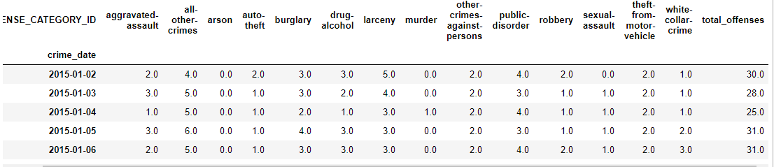
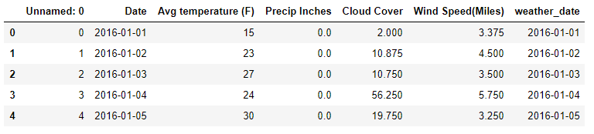
Data Cleanup & Exploration
Violent Crime:
filter for "Is Crime" = 1
Excluded traffic related offenses
Grouped .csv data by: Occurrence_date & Offense Type
Denver Weather:
Avg temperature (F) per day
Multiple values per day:
Sum of precipitation (inches)
Avg cloud cover (%)
Avg wind speed (mph)
Notes:
April – Crime
Lisa - Weather

Slide 5
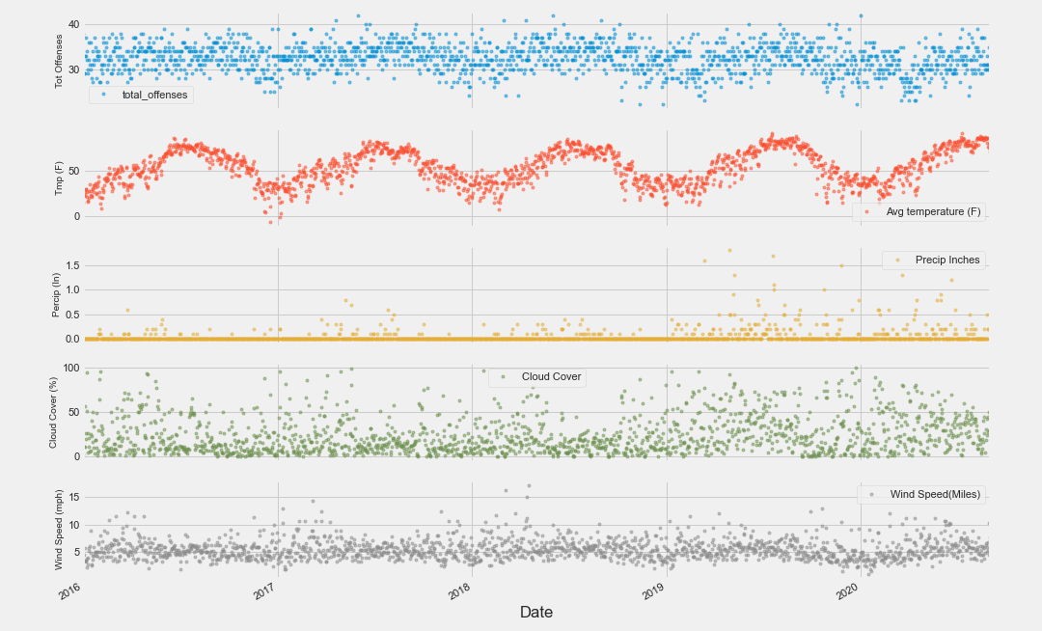

Data Over Time Analysis
To further view data over 5-year time period:
Scatter plot of Number of criminal offenses & Weather measures (y-axes) over 5 years (x-axis)
Notes:
Melanie

Slide 6

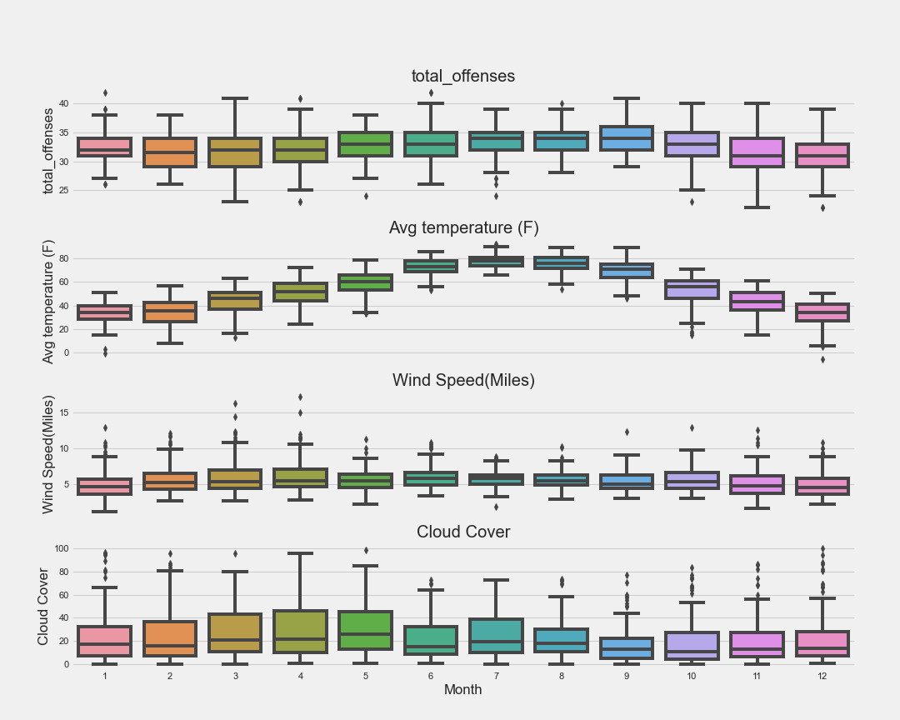
Seasonality Data Analysis
To further explore the seasonality of crime data in Denver:
Grouped 5 years data by months to view in boxplots the distribution of the data’s yearly seasonality
Notes:
Melanie

Slide 7
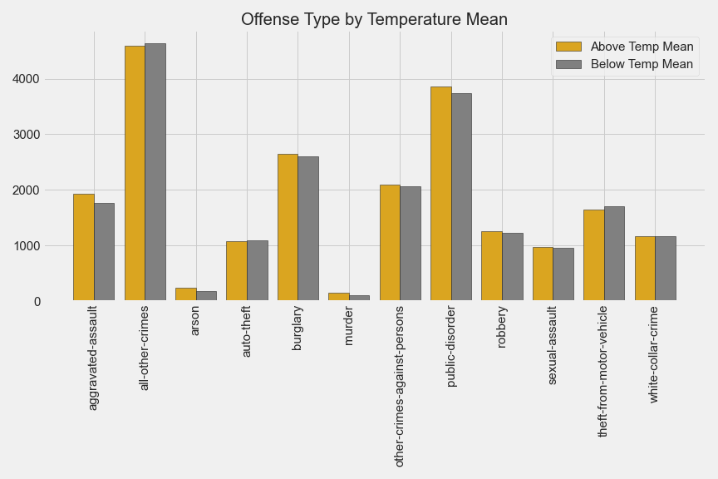
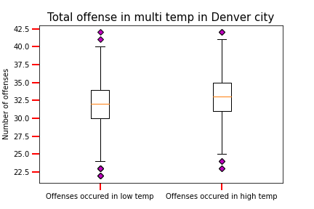
Data Analysis
Notes:
April

Slide 8
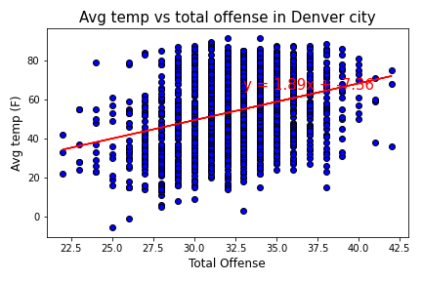
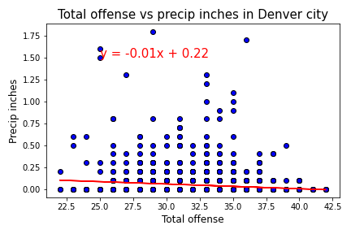
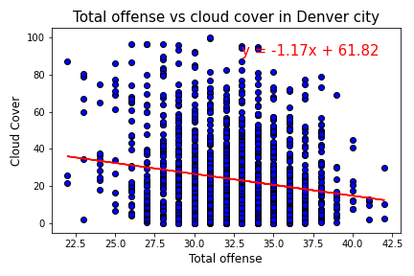
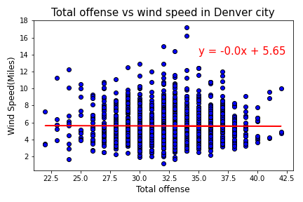
Discussion / Conclusion
1.
3.
Based on the p-value of # offenses to each weather condition…
Reject Null Hypothesis:
Avg Temp (F) = 9.06 e-42
Cloud Cover (%) = 2.23 e-06
Precipitation (in) = 1.02 e-13
Failed to Reject Null Hypothesis:
Wind Speed (mph) = 0.89
2.
4.
The results of the correlating (r-value) # offenses to each weather condition indicate a weak relationship between crime and weather conditions:
Avg Temp (F) = 0.32
Cloud Cover (%) = -0.18
Precipitation (in) = -0.11
Wind Speed (mph) = -0.0
Notes:
Lisa first p-value
Haifa r values

Slide 9

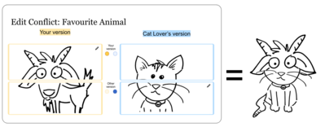
Post Mortem
Project Difficulties
Finding a topic to research
Finding a free weather API that pulled historical data
Finding large enough amounts of crime data with dates for free to compare to the weather
Questions started leading us away from the original scope
Git Hub challenges
Don’t use a blank .gitignore!!
It caused lots of unresolved conflicts of temp files
Notes:
Kathy

Slide 10
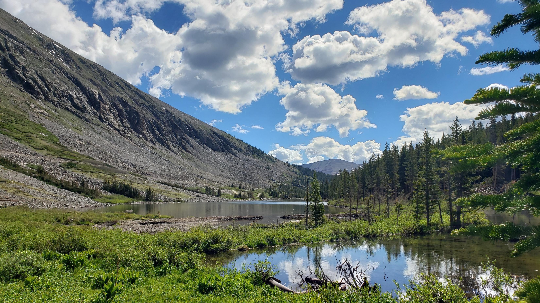
Questions?
Notes:
Melanie

